Slide 1


Slide 2
About MKCL
MKCL (Maharashtra Knowledge Corporation Limited) is a public limited company created under Directorate of Technical Education, Mumbai and General Administrative Department (GAD), Government of Maharashtra in 2018
Established to create new paradigms in Education, Development, Governance, and Empowerment (EDGE) through innovative digital solutions and capacity building

Slide 3





MKCL’s Educational Programs

Slide 4
MKCL’s Educational Programs
1.6 Crores Learners

Slide 5
MKCL’s Educational Programs

Slide 6
MKCL’s Educational Programs
10 Lakh+ Learners

Slide 7
MKCL’s Educational Programs

Slide 8
MKCL’s Educational Programs
6 Lakh+ Learners

Slide 9
Our Goal
To help millions of people to bridge
Digital Divide
Knowledge Divide
Development Opportunity Divide
AI Divide

Slide 10


MS-ACIT
(IT for Teachers)
Maharashtra state
Advance certificate COURSE in
Information technology
Notes:
MKCL has come up with the right course – MS-ACIT (Maharashtra State- Advanced Certificate in Information Technology) i.e. IT for Teachers.

Slide 11

Course Objective

Slide 12
To enable educators to identify, apply, analyze, create, manage, and evaluate digital tools and teaching practices for modern classrooms.

Slide 13
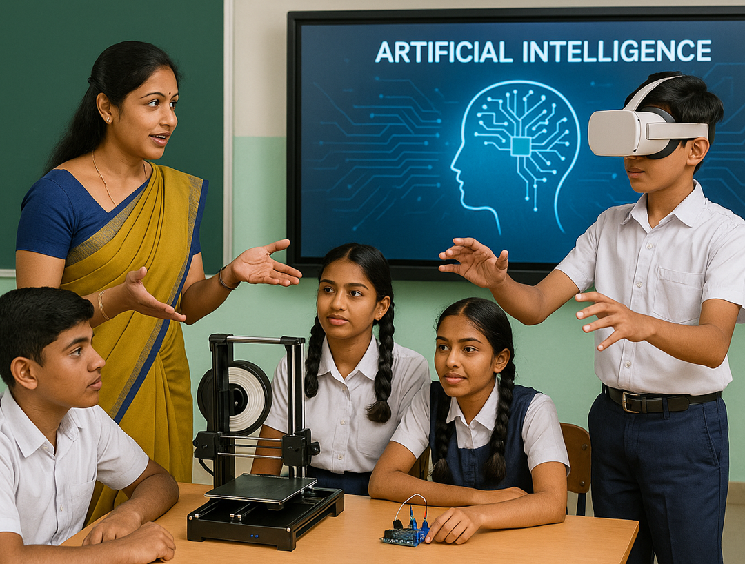
Empowering Educators with
MS-ACIT (IT for Teachers)
Transforming Classrooms through Digital Pedagogy

Slide 14
Why MS-ACIT for Teachers?

Slide 15
Why MS-ACIT for Teachers?
21st Century Skills for Modern Classrooms
Enables digital, inclusive, and engaging teaching
Aligns with NEP 2020 vision
Suitable for school & college-level education

Slide 16
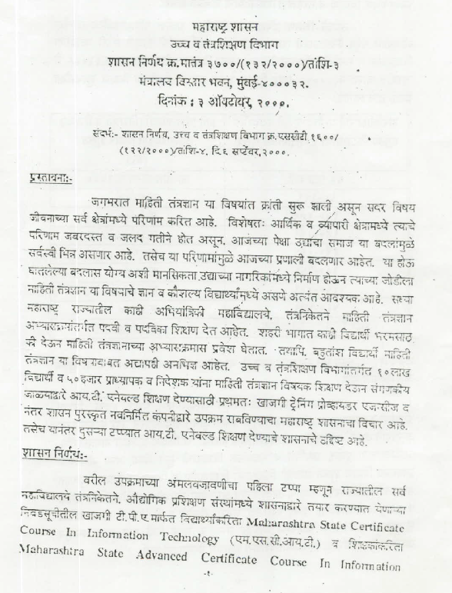
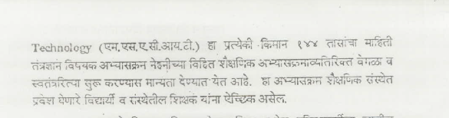
MS-ACIT (IT for Teachers) Government Resolutions

Slide 17
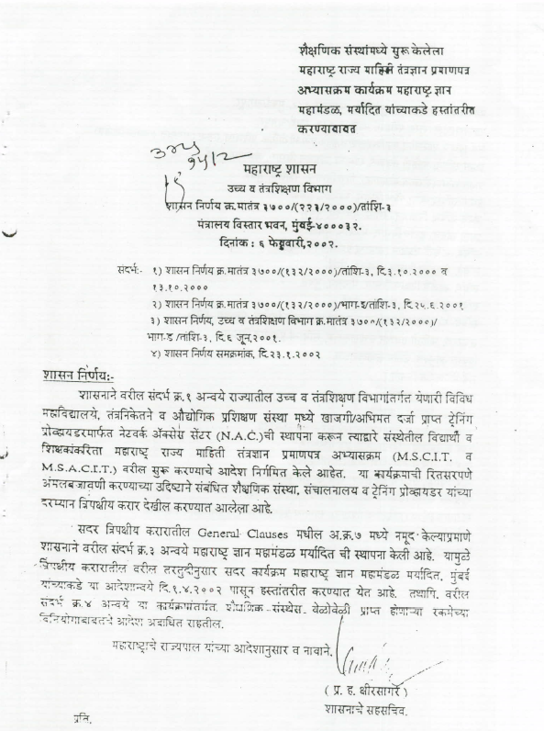
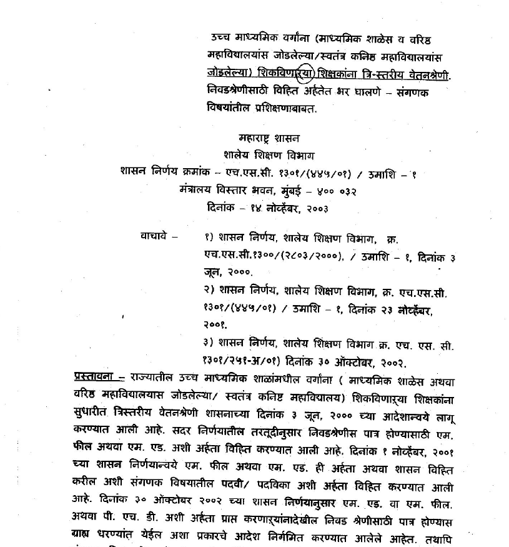

Slide 18
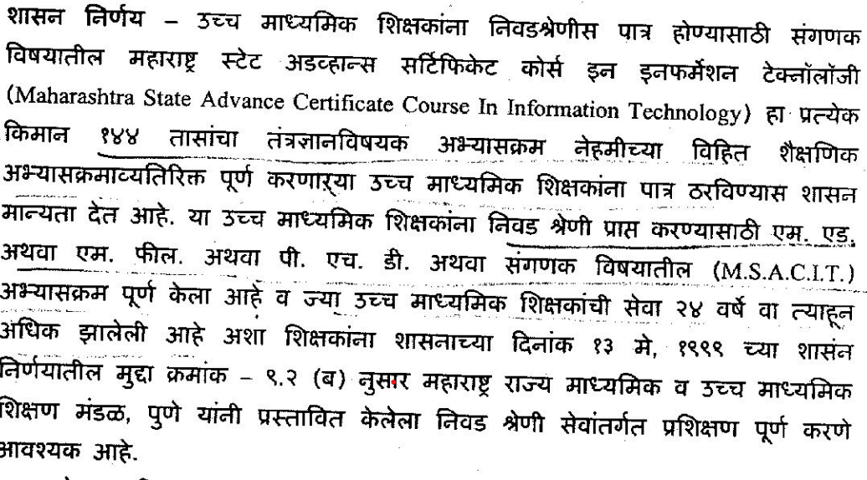

Slide 19
MS-ACIT (IT for Teachers)
Website https://msacit.mkcl.org/

Slide 20
MS-ACIT (IT for Teachers) Government Resolution
Joint Certificate by MSBTE and MKCL

Slide 21
MS-ACIT (IT for Teachers)
Now in New Form with
Updated Content and useful
AI Tools

Slide 22
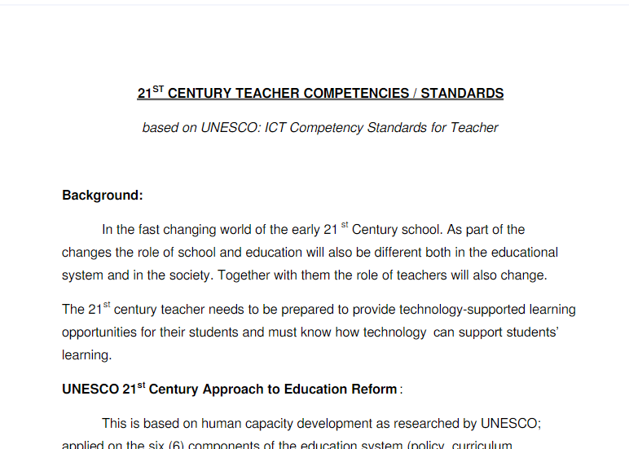


Slide 23
Roles of 21st Century Teacher
Technology Facilitator
Classroom Facilitator
Academic Facilitator
eContent Developer
eAssessment Developer
Lifelong learner
Researcher
Techno pedagogue
eTutor
Notes:
In MS-ACIT, teachers are attaining the skills to be able to perform these roles.

Slide 24
UNESCO 21st Century Approach to Education Reform | MS-ACIT encompasses these elements
On Curriculum & Assessment | Teaching Learning Assessment Skills
On Pedagogy | Teaching Learning Assessment Methods
On ICT | Technical skills
On Organization & Administration | Projects to implement the skills and methods in the classroom
On Teacher Professional Development | Using Web based teaching tools and creating resources
Notes:
International Standards

Slide 25
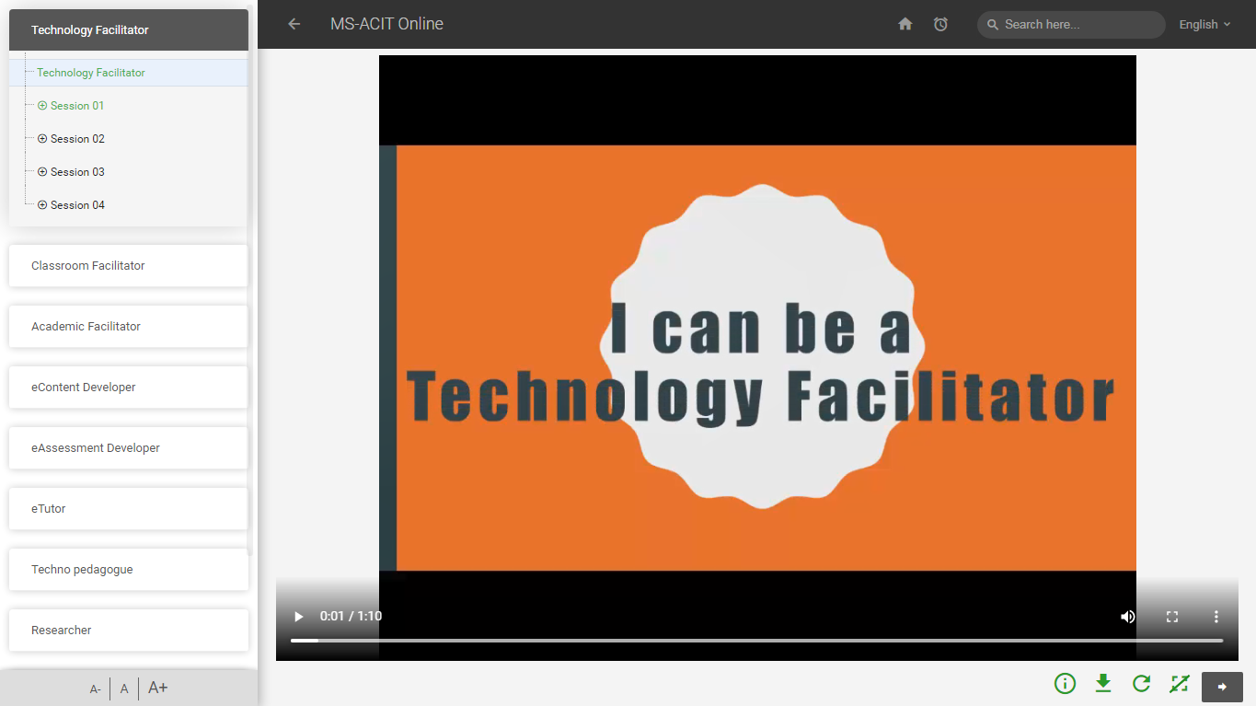
Notes:
The skills best suitable for these roles are distributed in 50 sessions.

Slide 26
MS-ACIT Course Curriculum comprises of:
Teaching Learning Assessment Methods and Skills
Technical Skills and Tools
Notes:
MS-ACIT Course Curriculum comprises of:

Slide 27
Syllabus Details

Slide 28
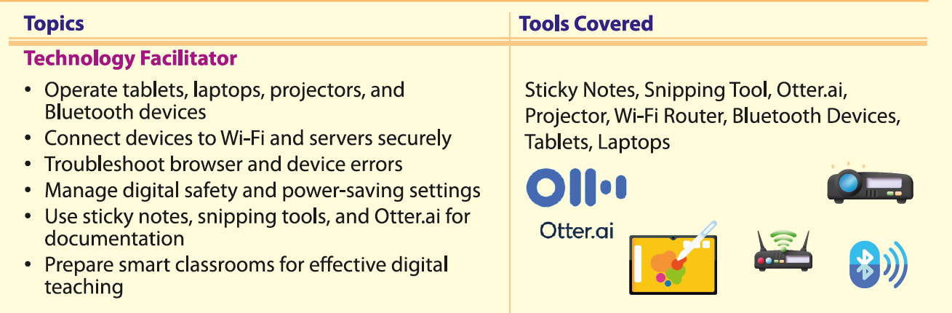

Slide 29
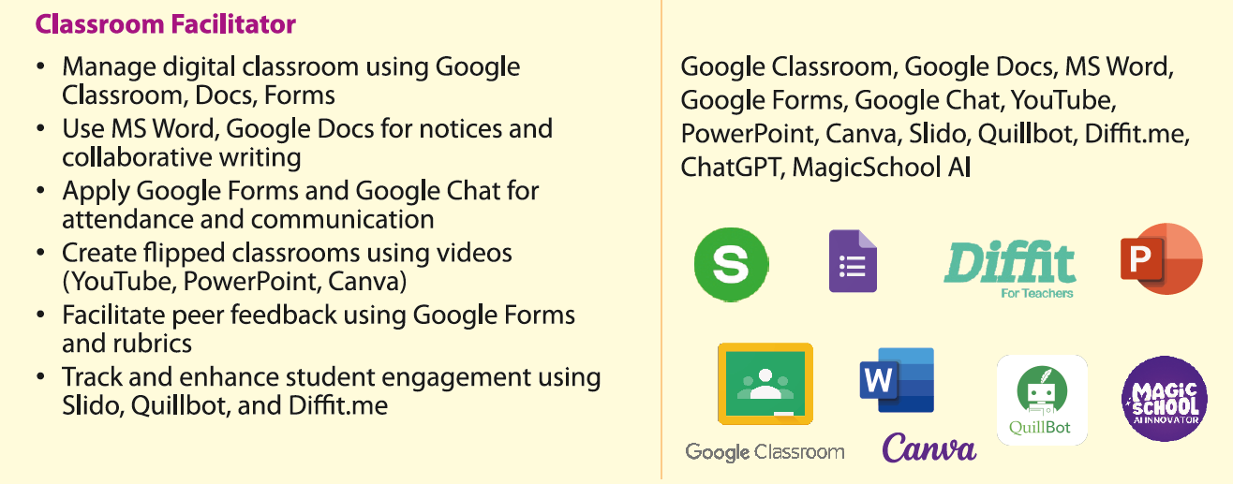

Slide 30
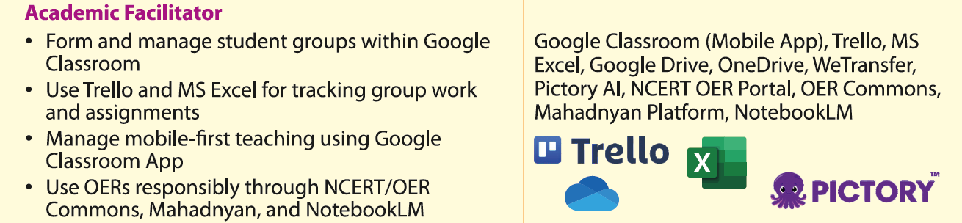

Slide 31
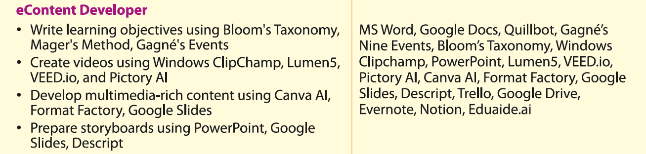

Slide 32
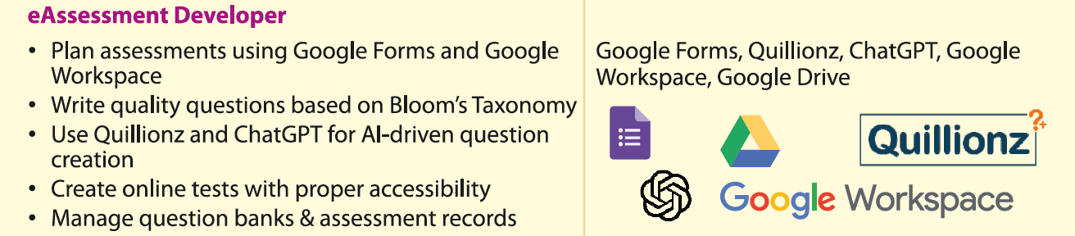

Slide 33
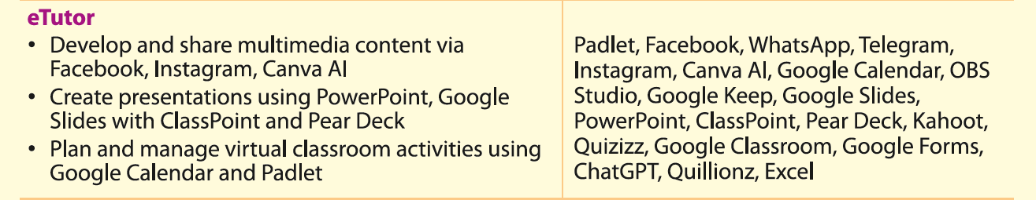

Slide 34
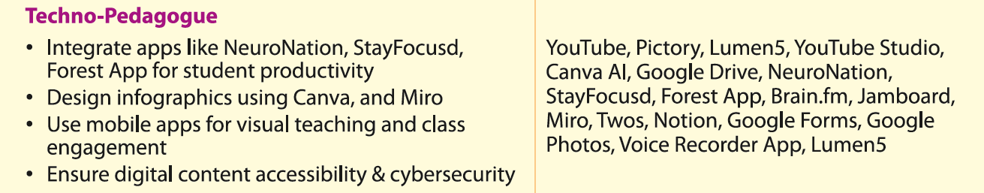

Slide 35
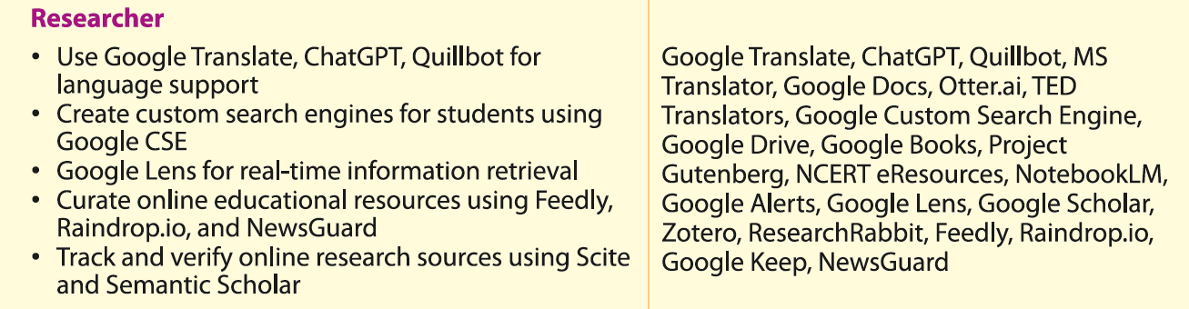

Slide 36
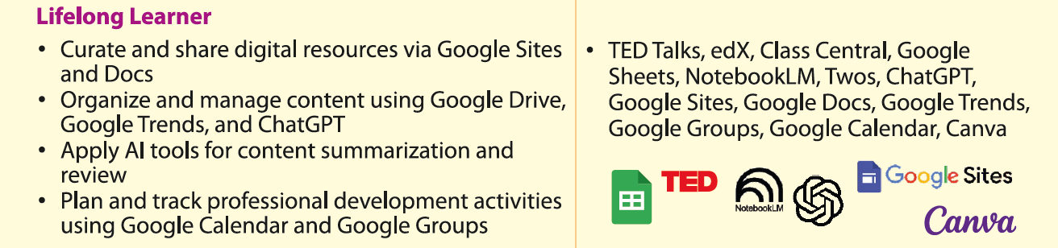

Slide 37
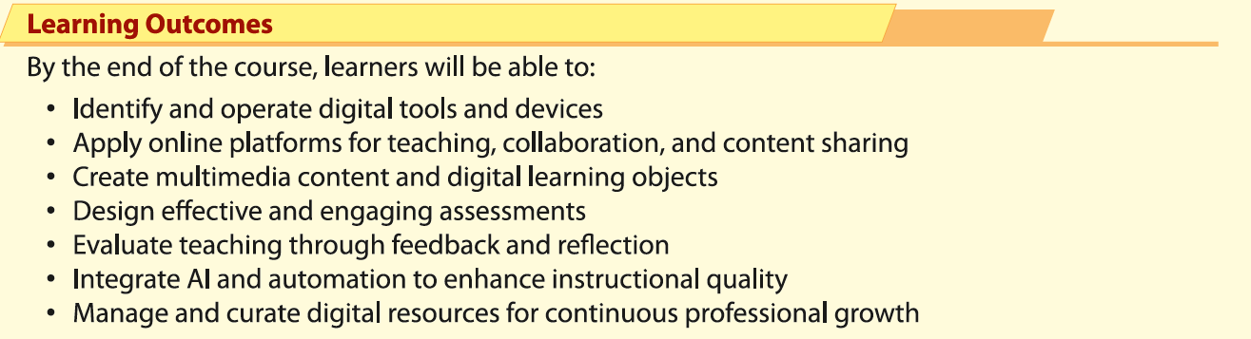

Slide 38
Session Plan

Slide 39
Session Range | Role Upliftment | Key Activities
Session 1-4 | Technology Facilitator | Operate devices, manage Wi-Fi, troubleshoot, use sticky notes and tools for classroom setup.
Session 5-10 | Classroom Facilitator | Manage digital classroom, create flipped classrooms, track engagement, use various Google tools.
Session 11-14 | Academic Facilitator | Manage student groups, track assignments, upload/download files, use OERs.
Session 15-25 | eContent Developer | Write learning objectives, create multimedia content, gather feedback for improvements.
Session 26-27 | eAssessment Developer | Plan assessments, create AI-driven questions, manage question banks.
Session 28-34 | eTutor | Conduct online classes, create presentations and quizzes, manage virtual activities.
Session 35-38 | Techno-Pedagogue | Use educational videos, design infographics, ensure accessibility, integrate productivity apps.
Session 39-42 | Researcher | Support language learning, curate resources, track online research, apply ethical considerations.
Session 43-45 | Lifelong Learner | Explore MOOCs, curate resources, plan professional development using AI tools.
Session 46 | Knowing MKCL's Various Enabling Frameworks and Courses | Understand MKCL's frameworks, map learning pathways, communicate digital strategy.
Session 47-50 | Final Exam Practice | Revise sessions, complete mock tests, collaborate with peers, prepare for real-world classrooms.
50 Sessions | TOTAL | 50 Marks

Slide 40
Teaching Learning Assessment Methods and Skills
Flipped Classroom
Peer Review
Student engagement with questioning
Promoting active participation in learning
Constructing questions using Bloom’s Taxonomy
Notes:
Teaching Learning Assessment Methods and Skills
Flipped Classroom
Peer Review
Student engagement with questioning
Promoting active participation in learning
Constructing questions using Bloom’s Taxonomy

Slide 41
Technical Skills and Tools
Connecting external devices to the computer
Managing Classroom using Google Calendar
Creating online poll
Creating quiz using PowerPoint
Preparing video using Windows Movie Maker
Inserting audio in PowerPoint
Recording screen using Camtasia
Notes:
Technical Skills and Tools
Connecting external devices to the computer
Managing Classroom using Google Calendar
Creating online poll
Creating quiz using PowerPoint
Preparing video using Windows Movie Maker
Inserting audio in PowerPoint
Recording screen using Camtasia

Slide 42
Technical Skills and Tools
Using Facebook as teaching tool
Building virtual classroom using WizIQ
Creating Google Plus Community for class
Sharing notes on class blog
Connecting student and parents using Google Sites
Creating online test
Creating infographics using Piktochart
Notes:
Using Facebook as teaching tool
Building virtual classroom using WizIQ
Creating Google Plus Community for class
Sharing notes on class blog
Connecting student and parents using Google Sites
Creating online test
Creating infographics using Piktochart

Slide 43
Academic Facilitator
“I” Statements
I can create groups in Google Classroom
I can manage learning content on mobile device
I can upload and download files to virtual classroom
I can share large files with students
Notes:
I can create groups in Google Classroom
I can manage learning content on mobile device
I can upload and download files to virtual classroom
I can share large files with students

Slide 44
Technology Facilitator
“I” Statements
I can connect to Wi-Fi
I can connect laptop to the projector
I can take the screenshot of error using snipping tool
Notes:
I can write the error in the sticky notes
I can take the screenshot of error using snipping tool
I can connect to Wi-Fi
I can connect laptop to the projector

Slide 45
Classroom Facilitator
“I” Statements
I can make students engaged with questioning
I can create online poll
I can create Google classroom
Notes:
I can manage my classroom on tablet
I can flip my tab based classroom
I can make students engaged in questioning
I can create online poll
I can create Google classroom

Slide 46
“I” Statements
Academic Facilitator
I can create groups in Google Classroom
I can manage learning content on mobile device
I can upload and download files to virtual classroom
I can share large files with students
Notes:
I can create groups in Google Classroom
I can manage learning content on mobile device
I can upload and download files to virtual classroom
I can share large files with students

Slide 47
“I” Statements
eContent Developer
I can change the audio–video format online
I can record the screen using Camtasia
I can insert audio in the video
I can use online material considering copyright issues
Notes:
I can change the audio-video format online
I can record the screen using Camtasia
I can insert audio into the video
I can use online material considering copyright issues

Slide 48
“I” Statements
eAssessment Developer
I can prepare different types of questions
I can create online test
I can construct questions based on Bloom’s Taxonomy
Notes:
I can prepare different types of questions
I can create online test
I can construct questions based on Bloom’s Taxonomy

Slide 49
eTutor
“I” Statements
I can create a quiz in PowerPoint
I can answer the real-time questions in Google Slides
I can create crosswords and worksheets
I can create engaging videos
Notes:
I can create a quiz in PowerPoint
I can answer the real-time questions in Google Slides
I can create crosswords and worksheets
I can create engaging videos

Slide 50
Academic Details

Slide 51
Admission Mode:
      MS-ACIT (IT for Teachers)@ALC
      MS-ACIT (IT for Teachers)@Home

Slide 52
Course Duration:
      144 Hours
Language:
      English and Marathi

Slide 53
Duration:
Total 144 Hours
  50 Hours – Inform (concept understanding, demonstrations)
  50 Hours – Perform (practice, hands-on tasks)
  44 Hours – Reading Materials (self-study, exploration)

Slide 54
Academics:
      Total 50 Sessions
      2 Sessions Per Day

Slide 55
Admission Details

Slide 56
Admission, Learning and Examinations Calendar for
MS-ACIT Course in the year 2026
https://msacit.mkcl.org/admission

Slide 57
September 2026 Batch Schedule:
Batch | Last Date of Admission | Last Date of Learning | Tentative Date of Exam
September 2026 | Friday September 25, 2026 | Monday November 30, 2026 | December 10-15, 2026

Slide 58
Examination

Slide 59
Final Examination:
Sr.No. | Types of Assessment | Maximum Marks | Minimum Passing Marks
1 | Internal Assessment | 50 | 20
2 | Final Online Examination | 50 | 20
 | Total Marks | 100 | 40

Slide 60
Final Examination:
Minimum Eligibility: 20 Marks and 50 Sessions through internal assessment
Total Final Examination Marks: 50
Total Examination Attempts: 1+2 (Re-examination)

Slide 61


